Slide 1
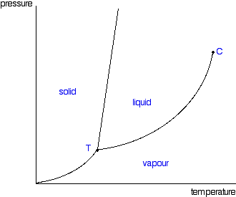
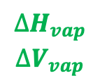
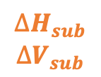
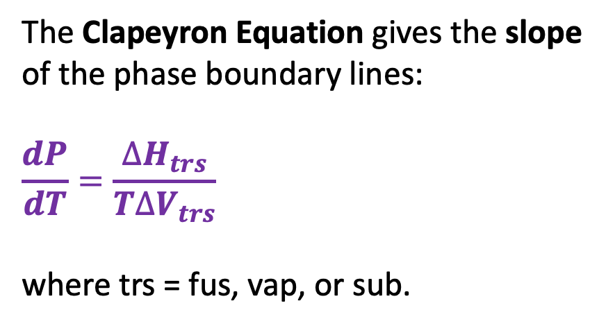
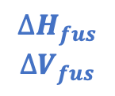

Recap: The Clapeyron equation
The Clapeyron Equation gives the slope of the phase boundary lines:
$$\frac{dP}{dT}=\frac{∆H_{trs}}{T∆V_{trs}}$$
where trs = fus, vap, or sub.
$$∆H_{fus}$$
$$∆V_{fus}$$
P
$$∆H_{vap}$$
$$∆V_{vap}$$
$$∆H_{vap}$$
$$∆V_{vap}$$
$$∆H_{sub}$$
$$∆V_{sub}$$
T

Slide 2
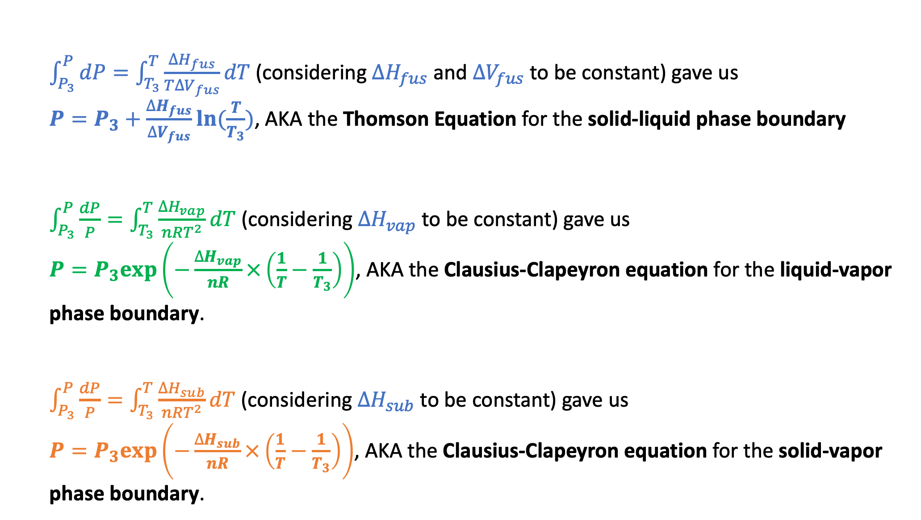
Recap: How Clapeyron integrated to Thomson and Clausius-Clapeyron
$\int_{P_{3}}^{P}{dP}=\int_{T_{3}}^{T}{\frac{∆H_{fus}}{T∆V_{fus}}dT}$ (considering $∆H_{fus}$ and $∆V_{fus}$ to be constant) gave us
$P=P_{3}+\frac{∆H_{fus}}{∆V_{fus}}ln⁡(\frac{T}{T_{3}})$, AKA the Thomson Equation for the solid-liquid phase boundary
$\int_{P_{3}}^{P}{\frac{dP}{P}}=\int_{T_{3}}^{T}{\frac{∆H_{vap}}{nRT^{2}}dT}$ (considering $∆H_{vap}$ to be constant) gave us
$P=P_{3}exp⁡\left(−\frac{∆H_{vap}}{nR}×\left(\frac{1}{T}−\frac{1}{T_{3}}\right)\right)$, AKA the Clausius-Clapeyron equation for the liquid-vapor phase boundary.
$\int_{P_{3}}^{P}{\frac{dP}{P}}=\int_{T_{3}}^{T}{\frac{∆H_{sub}}{nRT^{2}}dT}$ (considering $∆H_{sub}$ to be constant) gave us
$P=P_{3}exp⁡\left(−\frac{∆H_{sub}}{nR}×\left(\frac{1}{T}−\frac{1}{T_{3}}\right)\right)$, AKA the Clausius-Clapeyron equation for the solid-vapor phase boundary.

Slide 3
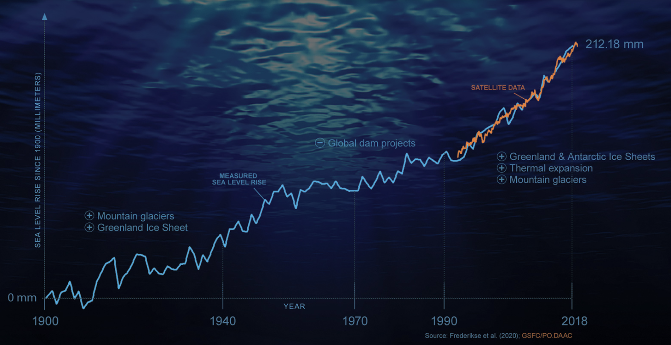
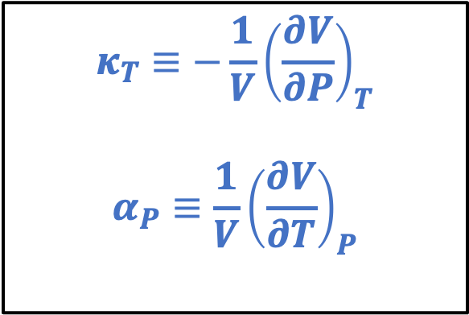
Recap: The “Isobaric expansivity” ($α_{P}$) and the “Isothermal compressibility” ($κ_{T}$)
$$κ_{T}≡−\frac{1}{V}{\left(\frac{∂V}{∂P}\right)}_{T}$$
$$α_{P}≡\frac{1}{V}{\left(\frac{∂V}{∂T}\right)}_{P}$$

Slide 4

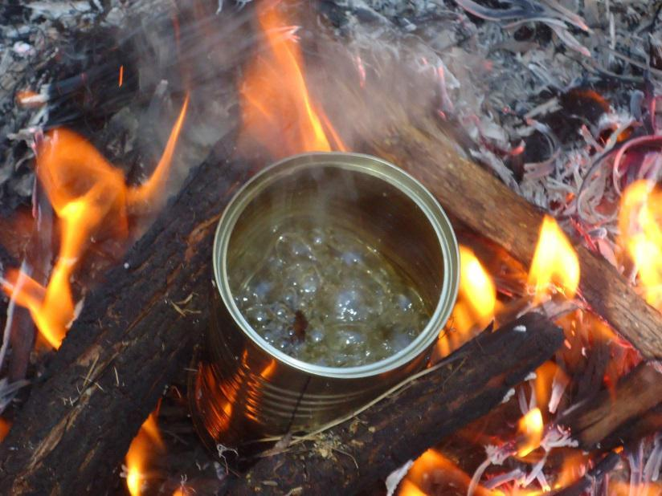
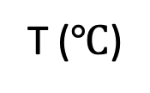


Recap: Why water boils at a lower temperature on Mt. Rainier
P
Standard atmospheric pressure
Atmospheric pressure on Mt. Rainier
Boiling happens at a lower temperature on Mt. Rainier because atmospheric pressure is lower there.
T ($℃$)
$$<100$$
$$100$$

Slide 5



Recap: Raoult’s Law
P
A(g)
${P_{A}=P}_{A}^{∗}χ_{A}$
New equilibrium
A
$$P_{A}^{∗}$$
B
A
A
A
A
Solvent A with solute B
B
$$P_{A}$$
T ($℃$)
A
A
Here, $χ_{A}$ is the mole fraction of solvent A in the solution,
$χ_{A}≡\frac{n_{A}}{n_{A}+n_{B}}$. A handy formula: $χ_{A}=\frac{1}{1+M_{A}b_{B}}$ where $b_{B}≡\frac{mol B}{kg A}$ is the solute’s molality.

Slide 6
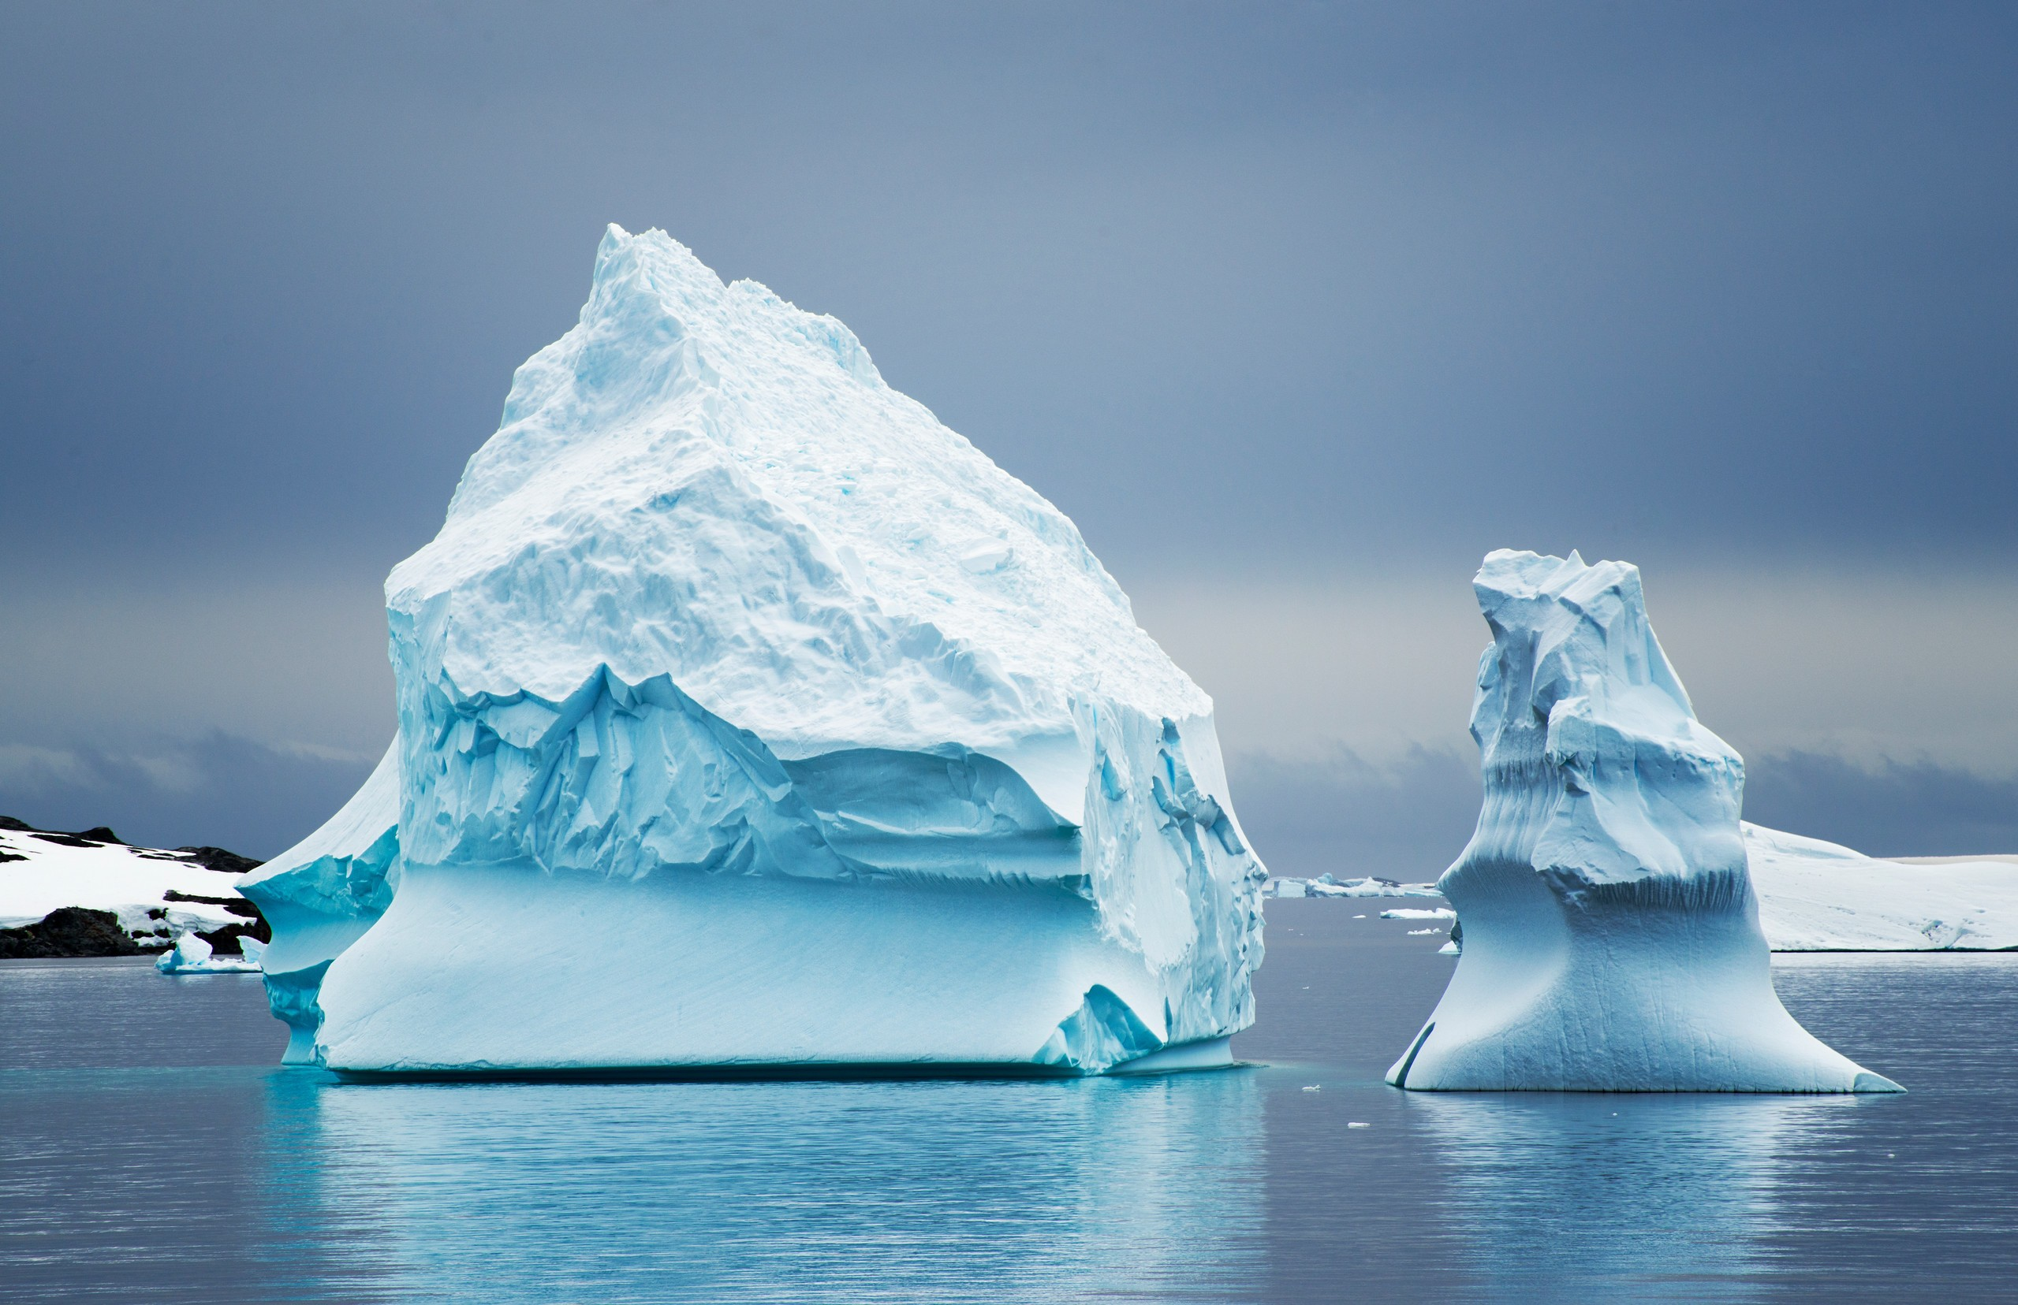



Recap: How Raoult explains freezing point depression
P
$$P_{A}^{∗}$$
$$P_{A}$$
$$∆T_{F}$$
T

Slide 7




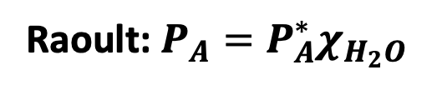
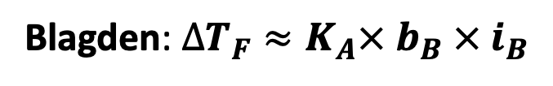

Recap: The connection between Raoult and Blagden
P
Raoult: $P_{A}=P_{A}^{∗}χ_{H_{2}O}$
$∆T_{F}$
Blagden: $∆T_{F}≈K_{A}× b_{B} × i_{B}$
$$P_{A}^{∗}$$
$$P_{A}$$
$$b_{B}$$
$$∆T_{F}$$
T

Slide 8

Recap: Why it’s reasonable to guess that $K_{A}∝\frac{1}{∆H_{fus}}$
P
Raoult: $P_{A}=P_{A}^{∗}χ_{H_{2}O}$
$∆T_{F}$
Blagden: $∆T_{F}≈K_{A}× b_{B} × i_{B}$
$$P_{A}^{∗}$$
$$P_{A}$$
$$b_{B}$$
$$∆T_{F}$$
T

Slide 9

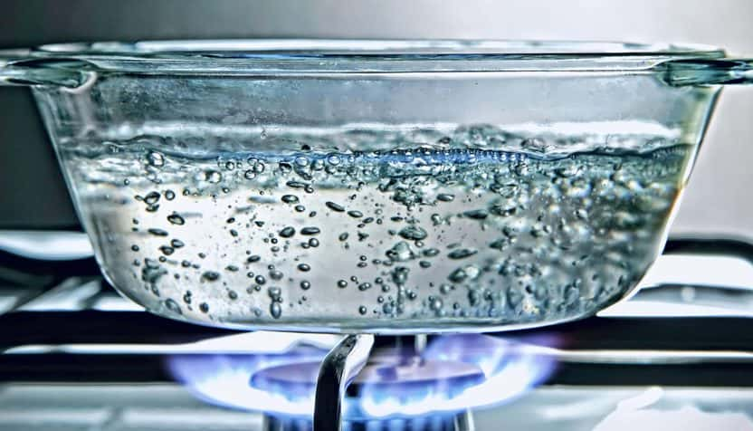

Blackboard work #1 for today: Explain why salty water boils at a higher temperature
P
$$P_{H_{2}O}^{∗}$$
Standard atmospheric pressure
NaCl
T
If you add salt to boiling water, it’ll stop boiling (for a moment, anyway).
With the burner on, the temperature will go up until it starts to boil again.

Slide 10
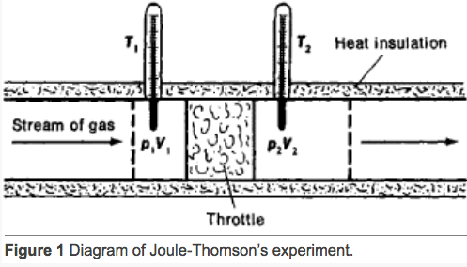
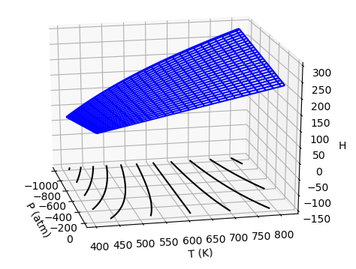

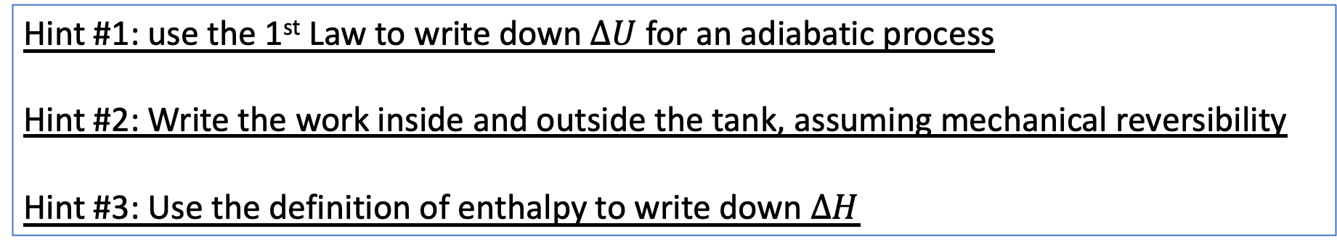
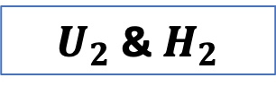
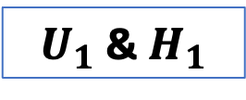
Blackboard work #2 for today: Explain why $∆H=0$ in the adiabatic Joule-Thomson experiment
$U_{1}$ & $H_{1}$
$U_{2}$ & $H_{2}$
Hint #1: use the 1st Law to write down $∆U$ for an adiabatic process
Hint #2: Write the work inside and outside the tank, assuming mechanical reversibility
Hint #3: Use the definition of enthalpy to write down $∆H$

Slide 11
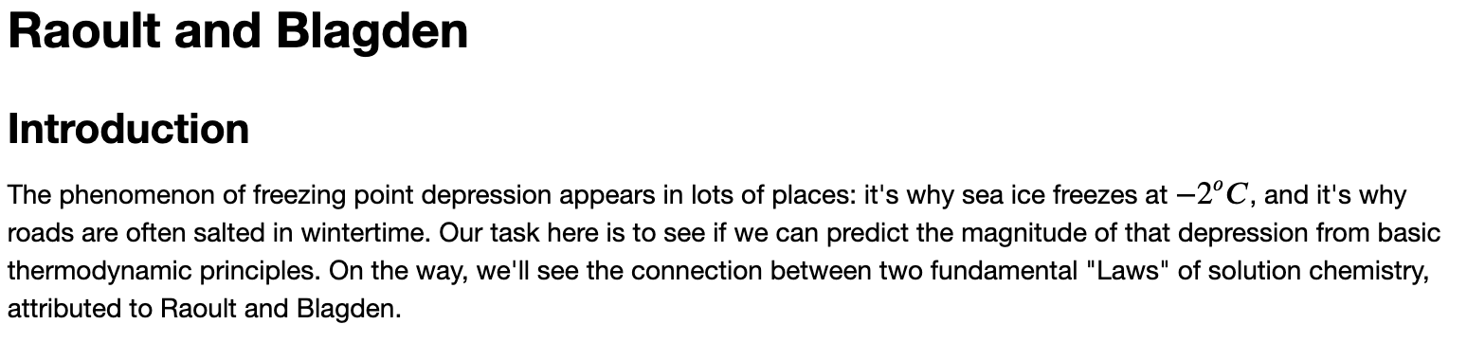
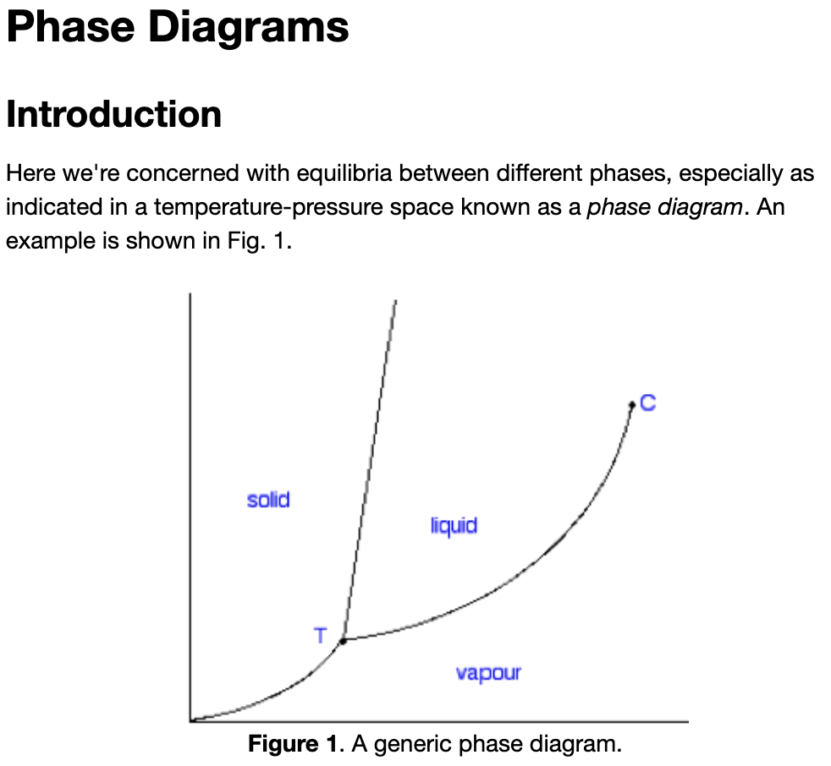
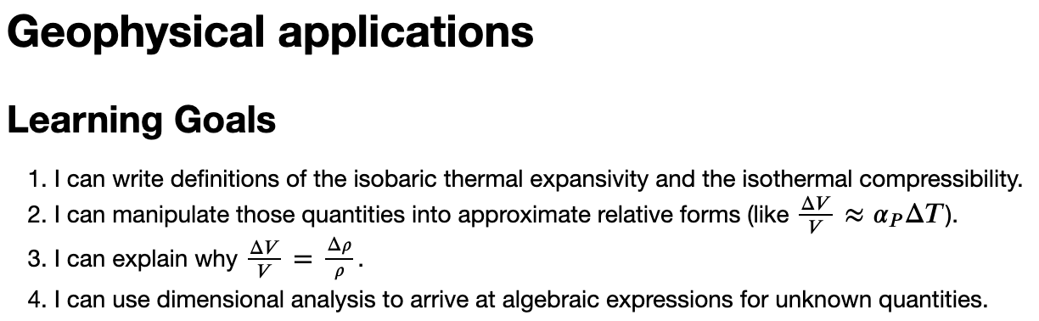
Wrapping up any remaining CGIs from this week

